Slide 1
A network analysis of
Actors/Directors and Movies
Simrat Benipal, Jose Perales, Ishrat Naba
Group # 11

Slide 2




DATASET
Dataset link: Netflix Movies and TV Shows (last updated 2021)
Dataset contains data on all TV Shows and Movies.
Data Cleaning: Remove TV Shows and Movie Descriptions, some other fields irrelevant to our study.
Cleaning/Removing data containing missing information.
Nodes: People (Cast, Directors) and Movies
Edge Links: People involved in a Movie
NARCOS
ARCANE
COWBOY BEBOP
LUCIFER
Notes:
Jose

Slide 3
EXPECTED SIZE
Expected Number of Movies (Nodes): 6,100
Expected Number of People (Nodes): 42,700
Expected Number of Links: 45,600
NARCOS
ARCANE
COWBOY BEBOP
LUCIFER
Notes:
Jose

Slide 4
NETWORK LAYOUT
Different Colors differentiate Actors/Actresses from Directors
Different Sizes reflect duration of movies.
Different Color to reflect year released.
Cluster movies based on TV rating (i.e. PG-13, TV-MA).
NARCOS
ARCANE
COWBOY BEBOP
LUCIFER
Notes:
Simrat

Slide 5
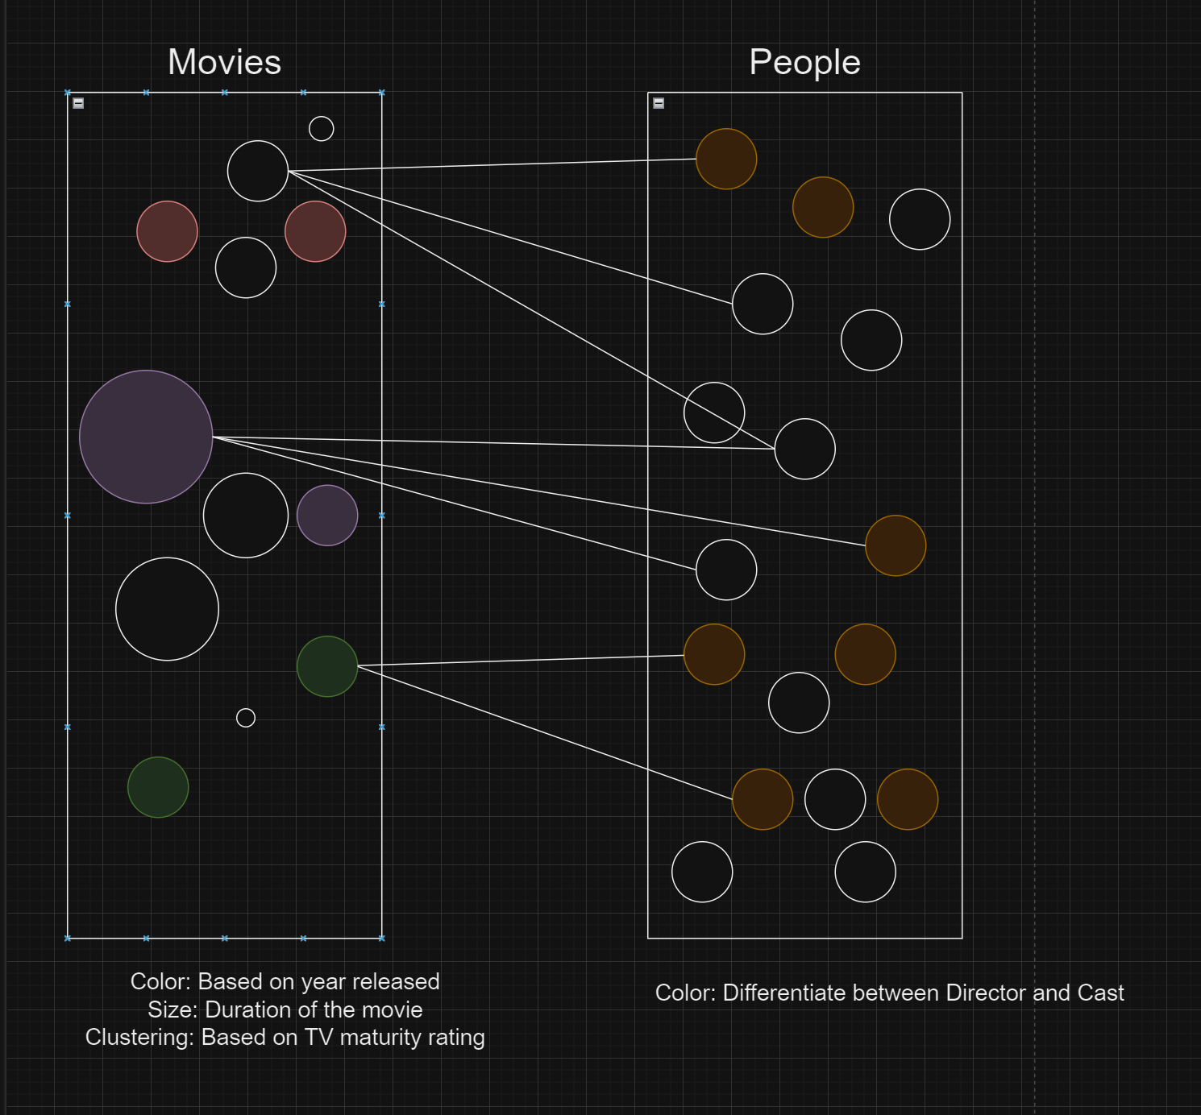
NETWORK LAYOUT
ARCANE
Notes:
Simrat

Slide 6









Questions to Ask
We want to answer questions about the people behind the movies made at Netflix, as well as some points about the kind of movies available on the platform. We want to see the personalities and types of movies the more infamous directors and actors would participate in, and how that may correlate to what Netflix prefers to release vs what does well. Some of our questions include:
Which movies perform the best and the worst per category?
Which ratings are most prevalent in movies released?
How directors prefer to shoot certain movies?
How actors/actresses decide which movies they want to partake in?
How are duration of the movies relate to TV Rating of the movie?
Analysis of Actor/Actresses and Directors
Are there any movies with multiple directors? If so, is it related to any particular reason?
Does Netflix keep old movies or all movies from recent years?
And more!
Notes:
Ishrat

Slide 7





16+
CC
WHY ANALYSIS OF NETFLIX
2020
|
English
Our analysis would be important to not just netizens and Netflix but also other streaming platforms who want to read how well their movies are performing with certain casts and directors, as well as why certain genres or durations are doing better than others. We can also understand how actors and directors eventually gain stardom and which movies provide that, and by starting off with a smaller network such as Netflix will allow us insight to that.
Netflix in particular caught our eye due to its popularity with the younger generations, its availability, well-designed UI and its easily accessible data. From a data analysis aspect, it will be the perfect size to read through since it's not too big or too small
Popularity
Large number of Movies
245+ million subscribers
6000+ Movies
Better availability than competitors
User-friendly interface
Netflix is available globally
Easy to navigate interface
Notes:
Ishrat

Slide 9
REFERENCES
Dataset::https://www.kaggle.com/datasets/shivamb/netflix-shows/data

